Slide 1
ConvE for Knowledge Base Completion
Tim Dettmers

Slide 2
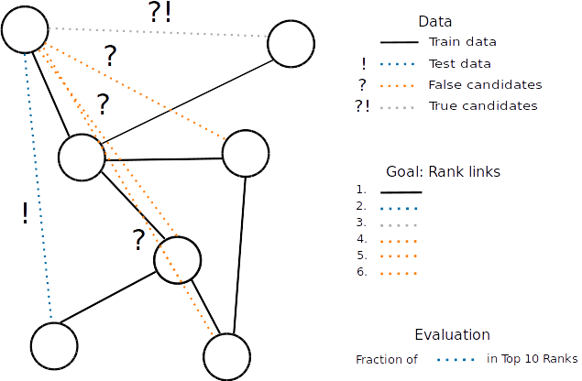
Knowledge Base Completion (KBC)

Slide 3

Problems with Language

Slide 4
Robustness of KBC models
DistMult on FB15k:
  2015 0.58 Hits@10
  2015 0.79 Hits@10
  2016 0.84 Hits@10 (not replicable)
  2017 0.81 Hits@10
  2017 0.82 Hits@10

Slide 5
Evaluation Time of KBC Models
Training one epoch on 150k samples: 1 min
Evaluating one epoch on 5k samples: 15 mins

Slide 6
Making KBC Fast and Robust
Fast: 1-N training
Robust: Computer vision methodology

Slide 7
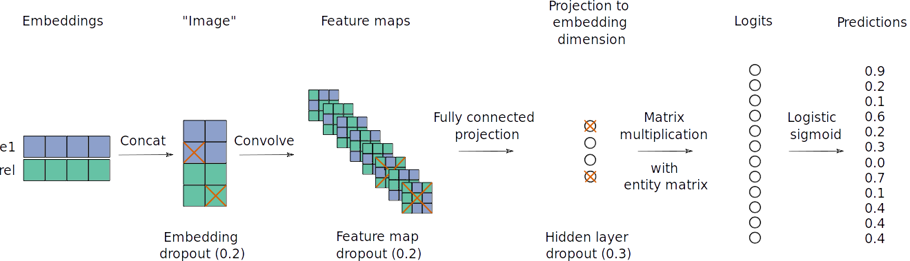
ConvE

Slide 8
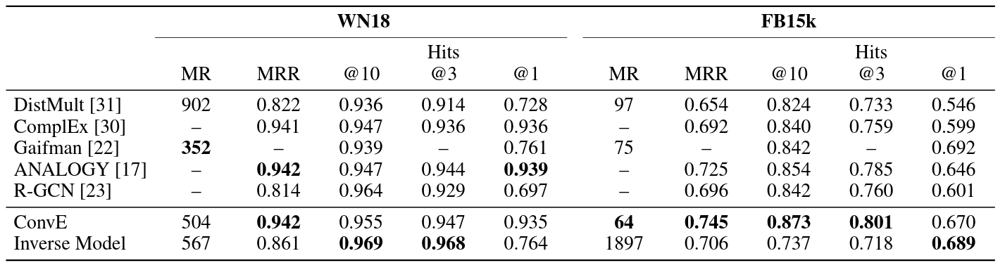
Inital Results

Slide 9
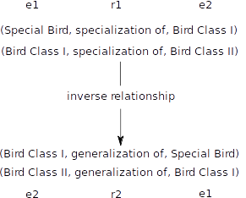
The Inverse Relationship Problem

Slide 10
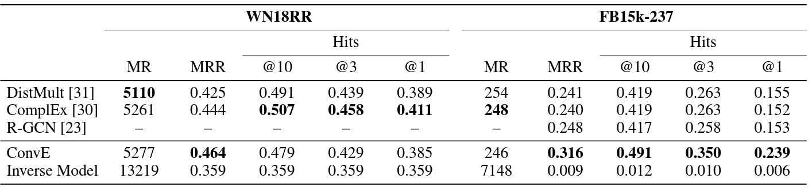
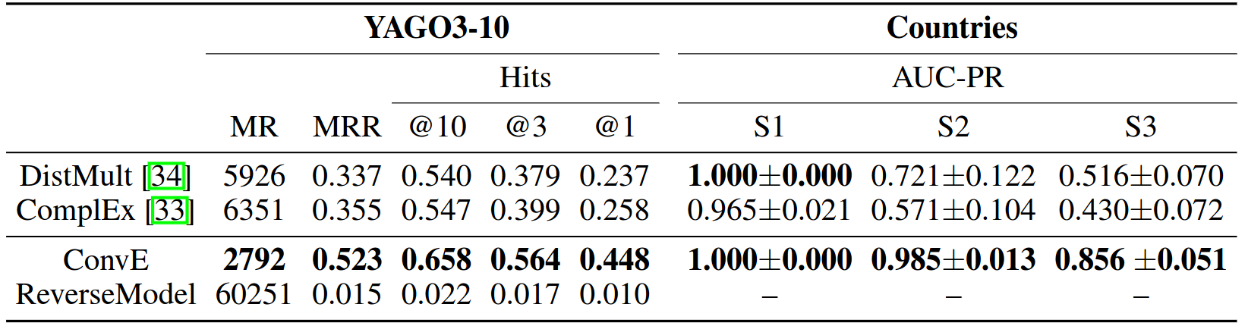
Results on Better Datasets

Slide 11
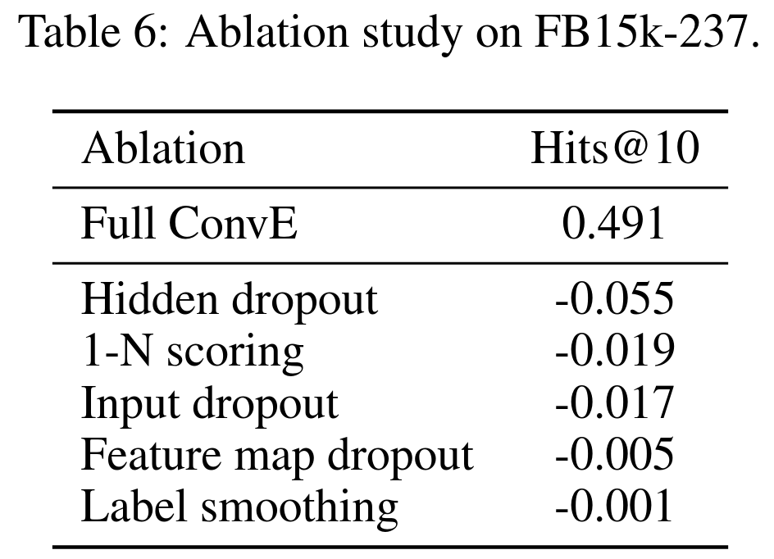
Ablation Study

Slide 12
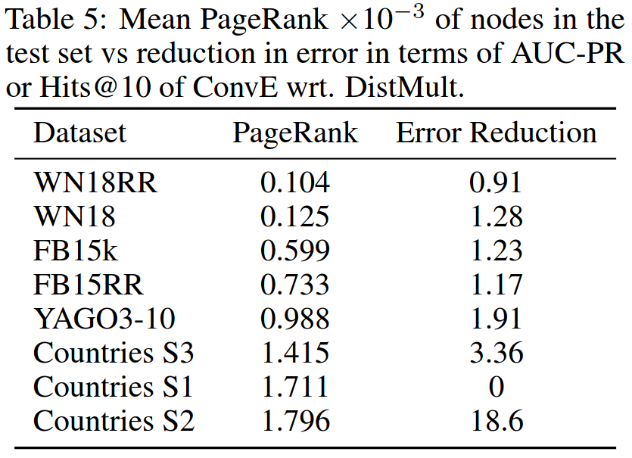
Why Are Results on WN18RR Bad?
ConvE good for nodes with high PageRank!

Slide 13
Robustness of KBC models
ConvE FB15k-237:
Random sample for input [0.1, 0.5], feature map [0.0, 0.5], and hidden dropout [0.1, 0.5]:
  0.45 – 0.49 Hits@10
  Previous State-of-the-art: 0.42

Slide 14
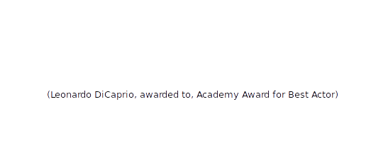
Future Work: Word Level KBC

Slide 15
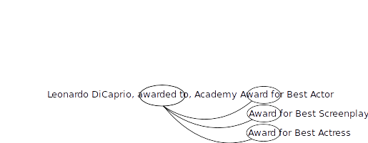
Future Work: Word Level KBC

Slide 16
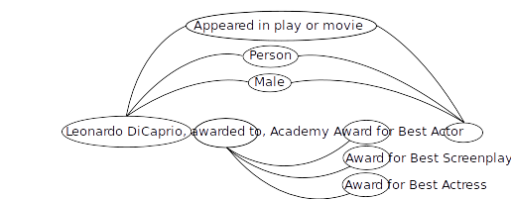
Future Work: Word Level KBC

Slide 17
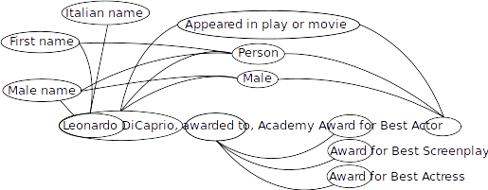
Future Work: Word Level KBC

Slide 18
Word Level KBC: Results
FB15k-237 (only words)
Normal ConvE: 0.08 Hits@10
Word-level ConvE: 0.32 Hits@10

Slide 19
Conclusion
ConvE:
Fast and robust training
Good predictive performance
Good for high PageRank nodes
Word-level models might improve performance

Slide 20

Questions & Answers

